Slide 1
Bioinformatics
Dr. Prativa Deka
Associate Professor
Department of Botany
Mangaldai College, Mangaldai
E-Mail: pdeka.mld@gmail.com

Slide 2
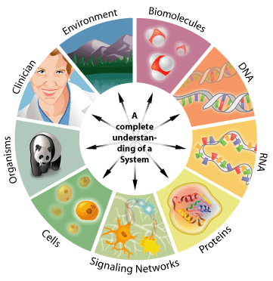
Bioinformatics: The field of science in which biology, computer science and information technology merge into a single discipline
Biologists
Collect Molecular Data:
DNA & Protein Sequences,
Gene Expression, etc.
Bioinformaticians
Study of Biological Questions by Analyzing Molecular Data
Computer scientists
(+Mathematicians, Statisticians, etc.)
Develop Tools, Softwares, Algorithms to Store and Analyze the Data.
Paulien hogeweg

Slide 3
From DNA to Genome
Sanger sequences insulin protein
Watson and Crick DNA model
1955
Dayhoff’s Atlas
1960
Sequence alignment
1965
ARPANET (early Internet)
PDB (Protein Data Bank)
1970
Sanger dideoxy DNA sequencing
1975
GenBank database
1980
PCR (Polymerase Chain Reaction)
1985

Slide 4
NCBI
SWISS-PROT database
FASTA
Human Genome Initiative
1990
BLAST
EBI
1995
World Wide Web
First bacterial genome
Yeast genome
First human genome draft
2000

Slide 5
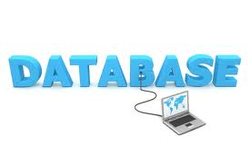
Biological Databases What is a database?
A collection of related data elements
tables
columns (fields)
rows (records)
Records retrieved using a query language
Database technology is well established

Slide 6
Tables (entitites)
basic elements of information to track, e.g., gene, organism, sequence, citation
Columns (fields)
attributes of tables, e.g. for citation table, title, journal, volume, author
Rows (records)
actual data
whereas fields describe what data is stored, the rows of a table are where the actual data is stored

Slide 7
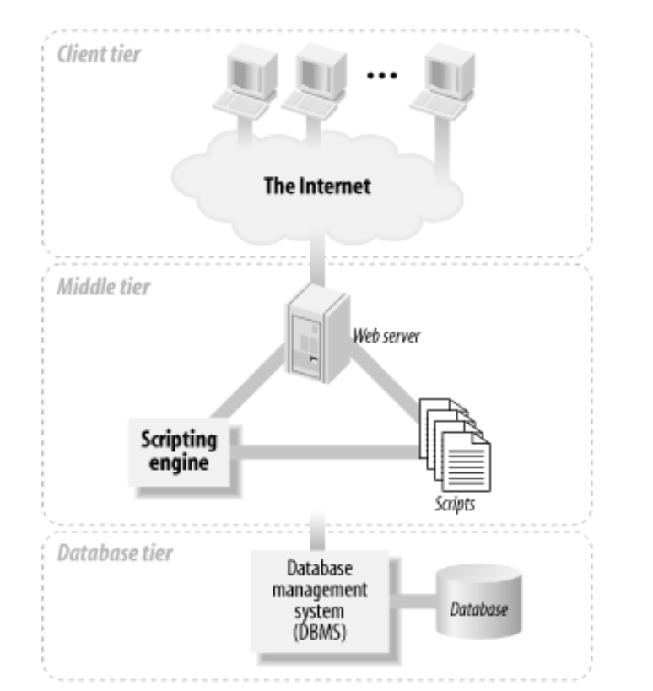
How online database work?
When you query an online database, your query is translated into SQL, the database is interrogated, and the answer displayed on your web browser.
Your computer and browser (the “client”)
Software to receive and translate the instructions you enter into your browser (on the “server”)
The database itself
Image source: David Lane and Hugh E. Williams. Web Database Applications with PHP & MySQL. O’Reilly (2002).

Slide 8
Why biological databases?
Make biological data available to scientists
Consolidation of data (gather data from different sources)
Provide access to large dataset that cannot be published explicitly (genome, proteome,…)
Make biological data available in computer-readable format
Make data accessible for automated analysis
Bioinformatics: “To extract, store and to analysis the biological data”

Slide 9
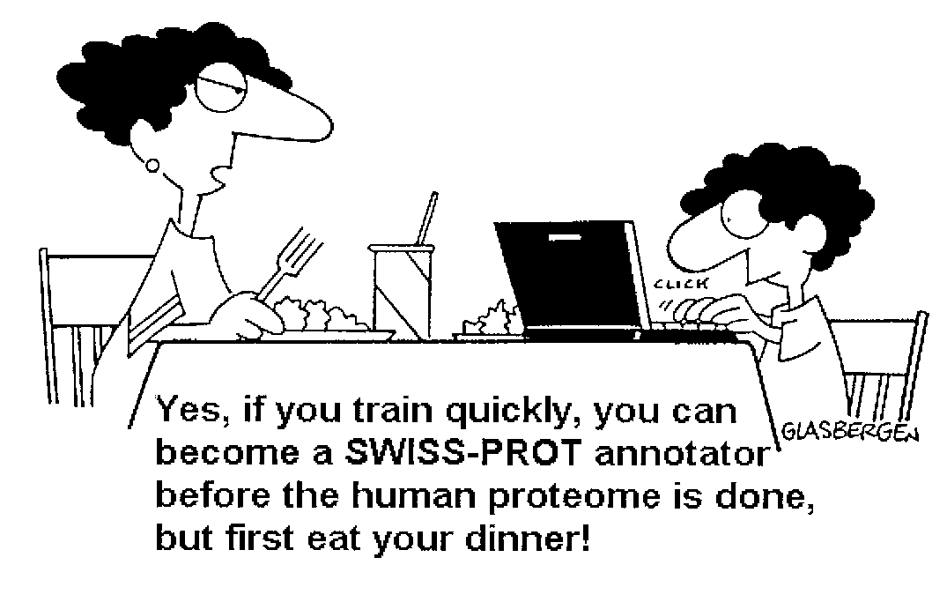
Biological Databases
Over 1000 biological databases
Vary in size, quality, coverage, level of interest
Many of the major ones covered in the annual Database Issue of Nucleic Acids Research
What makes a good database?
comprehensiveness
accuracy
is up-to-date
good interface
batch search/download
API (web services, DAS, etc.)

Slide 10
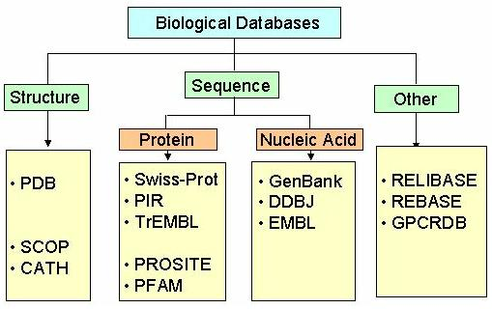
Types of Biological Databases

Slide 11
Flow of Databases in Bioinformatics
Biological experiments
Computational Biology
Biological Databases
Notes:
The purpose of databases is to curate the increasing amount of experimental data from various disciplines of biology
Bioinformatics can be viewed as this circle of science where high throughput experimental procedures produce large quantity of data
This data is stored and processed in databases from which it can be extracted for analysis with computational methods
The results form the computational methods in turn inspire additional experiments and hypotheses concerning biological phenomena

Slide 12
Plants Genomes Databases
Plant Genomes Databases

Slide 13
Ten Important Bioinformatics Databases
GenBank www.ncbi.nlm.nih.gov nucleotide sequences
Ensembl www.ensembl.org human/mouse/Plants genome
PubMed www.ncbi.nlm.nih.gov literature references
NR www.ncbi.nlm.nih.gov protein sequences
SWISS-PROT www.expasy.ch protein sequences
InterPro www.ebi.ac.uk protein domains
OMIM www.ncbi.nlm.nih.gov genetic diseases
Enzymes www.chem.qmul.ac.uk enzymes
PDB www.rcsb.org/pdb/ protein structures
KEGG www.genome.ad.jp metabolic pathways
In 1965, Dayhoff gathered all the available sequence data to create the first bioinformatics database (Atlas of Protein Sequence and Structure).

Slide 14
NCBI (National Center for Biotechnology Information)
over 30 databases including GenBank, PubMed, OMIM, and GEO
Access all NCBI resources via Entrez (www.ncbi.nlm.nih.gov/Entrez/)

Slide 16
Protein Data Bank (PDB)

Slide 17
BLAST For Sequence Alignment
Basic Local Alignment Search Tool
Altschul et al. 1990,1994,1997
A best method for local alignment
Designed specifically for database searches
Benefits-Speed, User friendly, Statistical rigor,
More sensitive
Types of BLAST- BLASTN, BLASTP, BLASTX, TBLASTN, TBLASTX

Slide 18
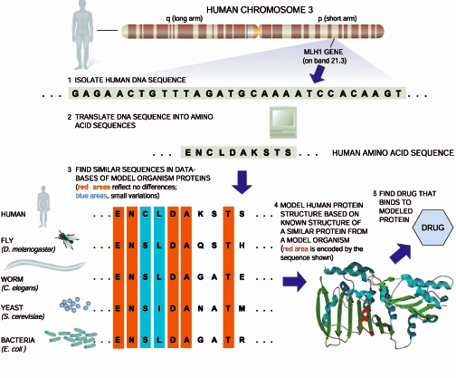
Luscombe, Greenbaum, Gerstein (2001)

Slide 19
THANK YOU

